Slide 1
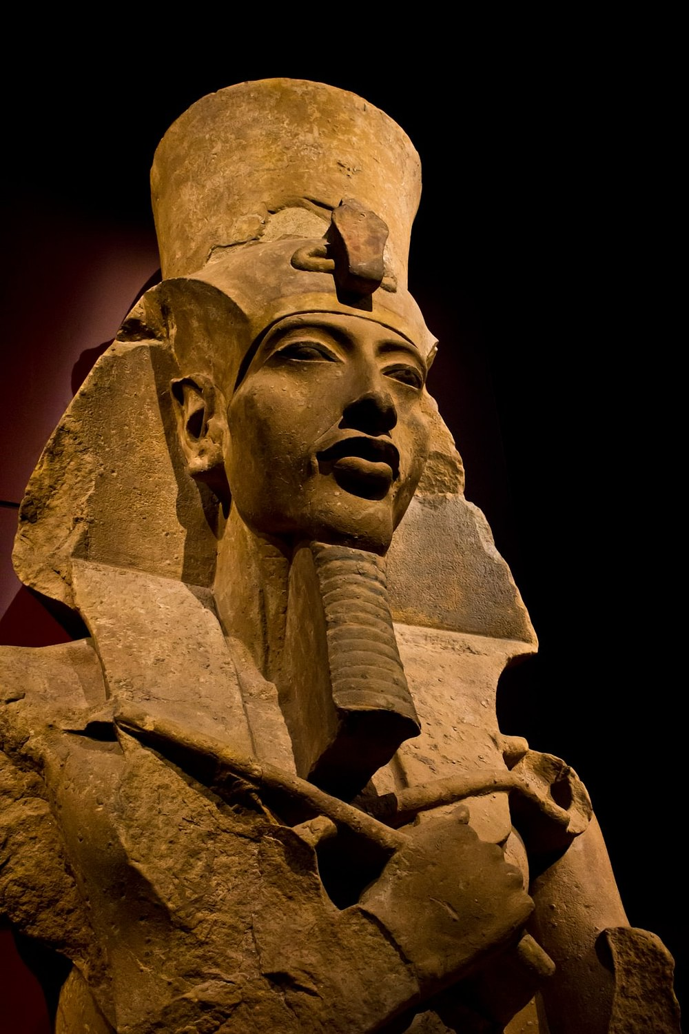
Introduction to Ancient Egypt
GOAL/S: Identify and describe the geographical features of Ancient Egypt
Week 8, Lesson 1

Slide 2

Work Expectations
Complete all tasks to the best of your ability
Catch up on missed work
Be organised – if you are not ahead you will fall behind
Have a go at everything
Use Compass and your textbooks
Create study resources
THIS IS YOUR LAST CHANCE TO GET THOSE C GRADES!
Notes:
NOTES: Permission Slips – viewing and study club

Slide 3
Course Overview
Resources and units
If you have any questions – please ask!

Slide 4
Unit 3 – Societies and Change
Term/Week | Topic/Content | Assessments
T2 – 8 - 9 | Eyptian Society Overview
T2 – 10 - 11 | Years 1 – 4: Amenhotep IV | Week 11 – Essay (15%)
TERM BREAK (Holidays)
T3 – 1 - 2 | Years 5 – 8 | Week 5 – Source Analysis (15%)
T3 – 3 - 5 | Years 9 – 11
T3 – 6 - 8 | Years 12 - 17 | Week 6 – 8 – Inquiry (10%)
T3 – 9 – 10 | Death of Akhenaten and rule of Tutankhamun | Week 10 – Test (15%)

Slide 5
Unit 4: Confrontation and Resolution
In this unit, students learn that there are internal and external forces that result in confrontation and resolution within societies, and these have consequences for continuity and change.
Students assess how power is used, how different groups and individuals respond, and whether there is the potential for greater confrontation or more effective resolution to conflict.
OUR ELECTIVE:
Egypt, Akhenaten and the Amarna Revolution, Amenhotep IV/ Akhenaten to the death of Horemheb
c. 1352 – c. 1295BCE

Slide 6
Key Terms:
Define in your book

Slide 7
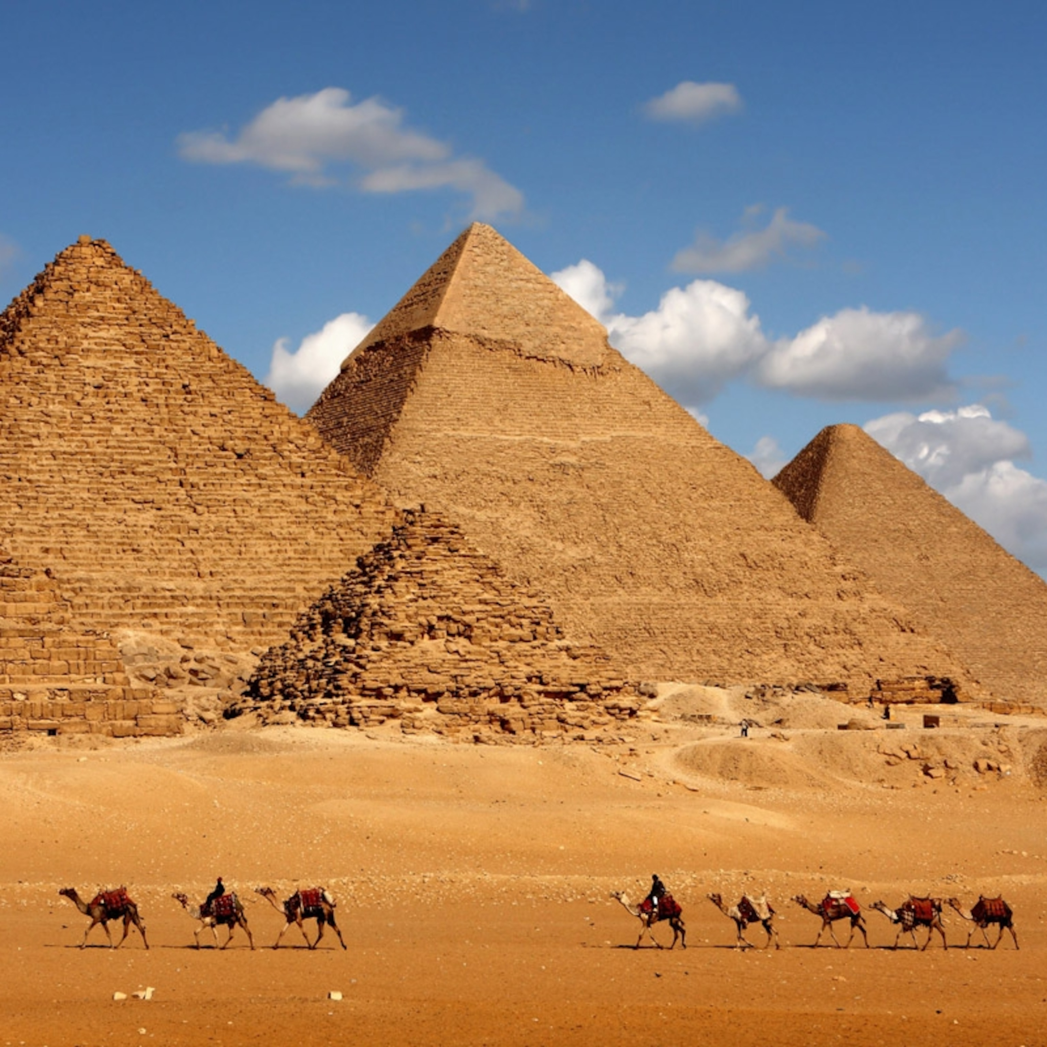
Egypt
KEY TERM
An ancient civilization located along the Nile River in northeastern Africa. It is known for its rich culture, monumental architecture, and intricate religious beliefs.
WHAT DO YOU ALREADY KNOW ABOUT ANCIENT EGYPT?

Slide 8
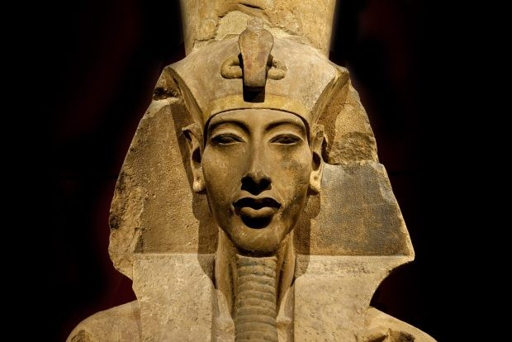
Akhenaten
KEY TERM
Also known as Amenhotep IV, Akhenaten was a pharaoh of the 18th dynasty of Egypt. He ruled from approximately 1353 BCE to 1336 BCE. Akhenaten is notable for his religious revolution, during which he promoted the worship of a single god, Aten, and suppressed other deities. His reign marked a departure from traditional Egyptian polytheism.
PRONOUNCED: ah-ken-AH-ten
Notes:
IV = 4

Slide 9
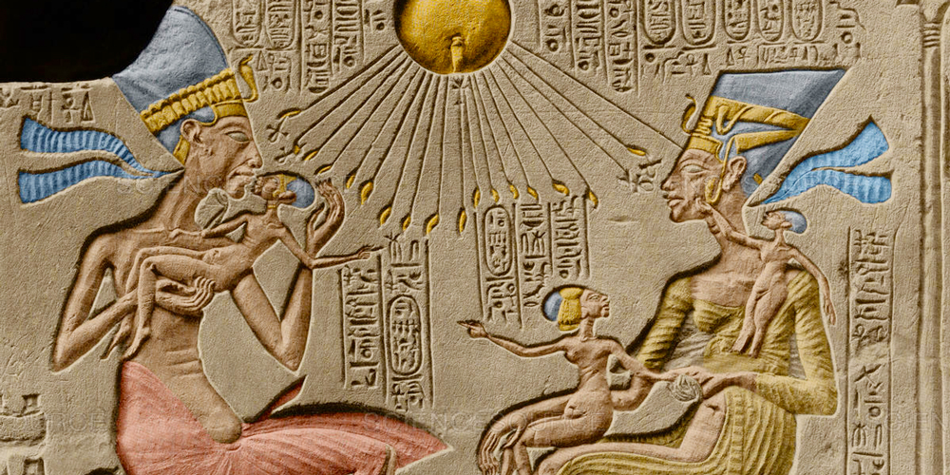
Amenhotep IV
KEY TERM
The birth name of Akhenaten. He later changed his name to Akhenaten to reflect his devotion to the god Aten.
PRONOUNCED: ah-MEN-hoh-tep
Notes:
IV = 4

Slide 10
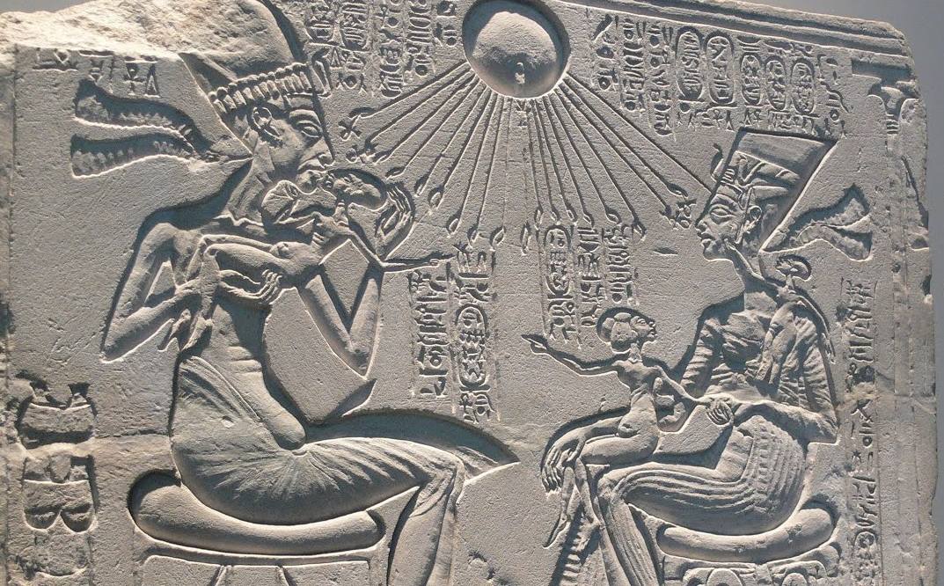
Amarna Revolution
KEY TERM
This refers to the religious and cultural changes initiated by Akhenaten.
He moved the capital from Thebes to a new city called Akhetaten (modern-day Amarna), where he focused on the worship of Aten.
The Amarna Period saw the suppression of traditional gods and the elevation of Aten to supreme status.
PRONOUNCED: ah-MAR-nah
Notes:
IV = 4

Slide 11
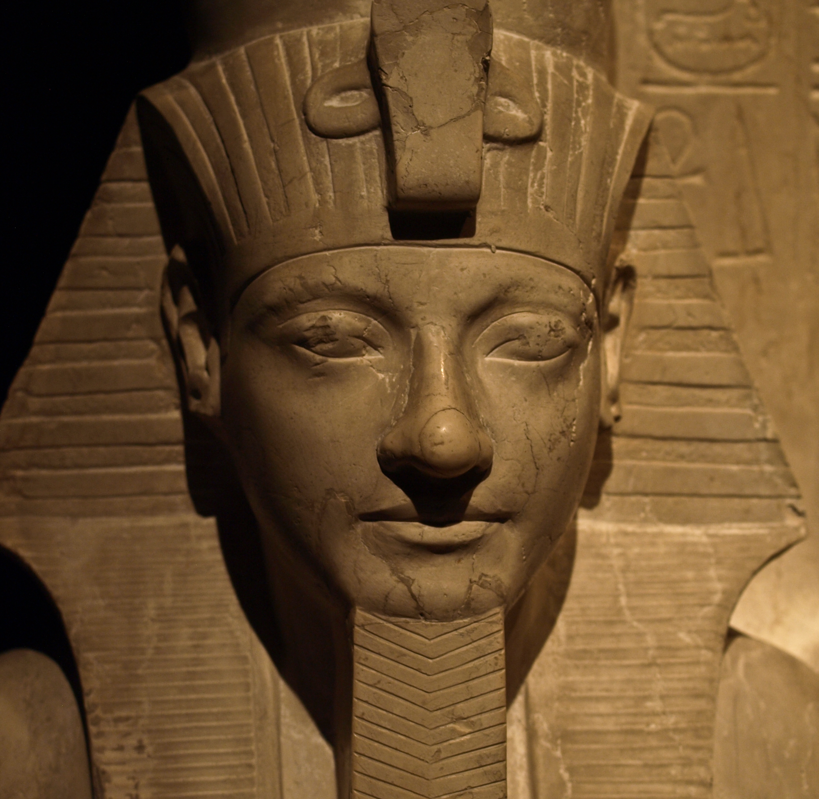
Horemheb
KEY TERM
A pharaoh who succeeded Akhenaten. His reign (approximately 1320 BCE to 1292 BCE) marked the end of the Amarna Period.
Horemheb restored traditional religious practices and erased Akhenaten’s legacy.
PRONOUNCED: hoh-REM-heb
Notes:
IV = 4

Slide 12
Ancient Egypt was a long, narrow country in north-eastern Africa. The world's longest river, the Nile, ran the length of the country. Ancient Egyptian lands were also surrounded by a huge desert. Both of these geographical features played very important roles in the development of ancient Egyptian society.

Slide 13
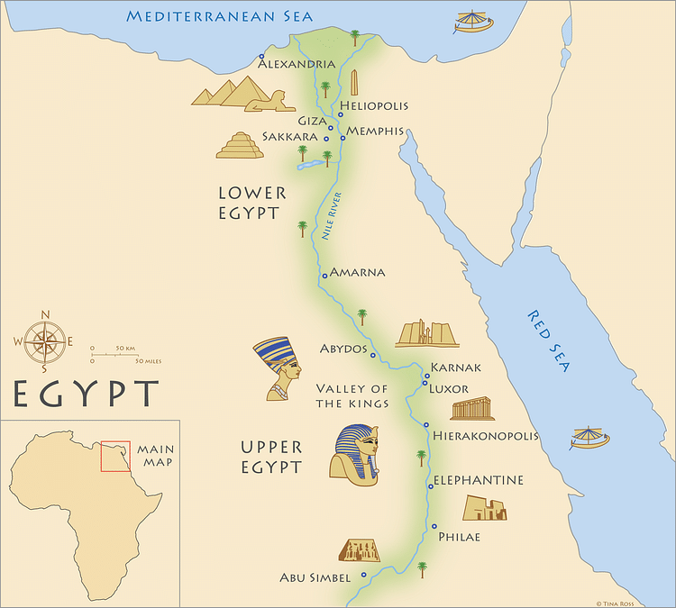
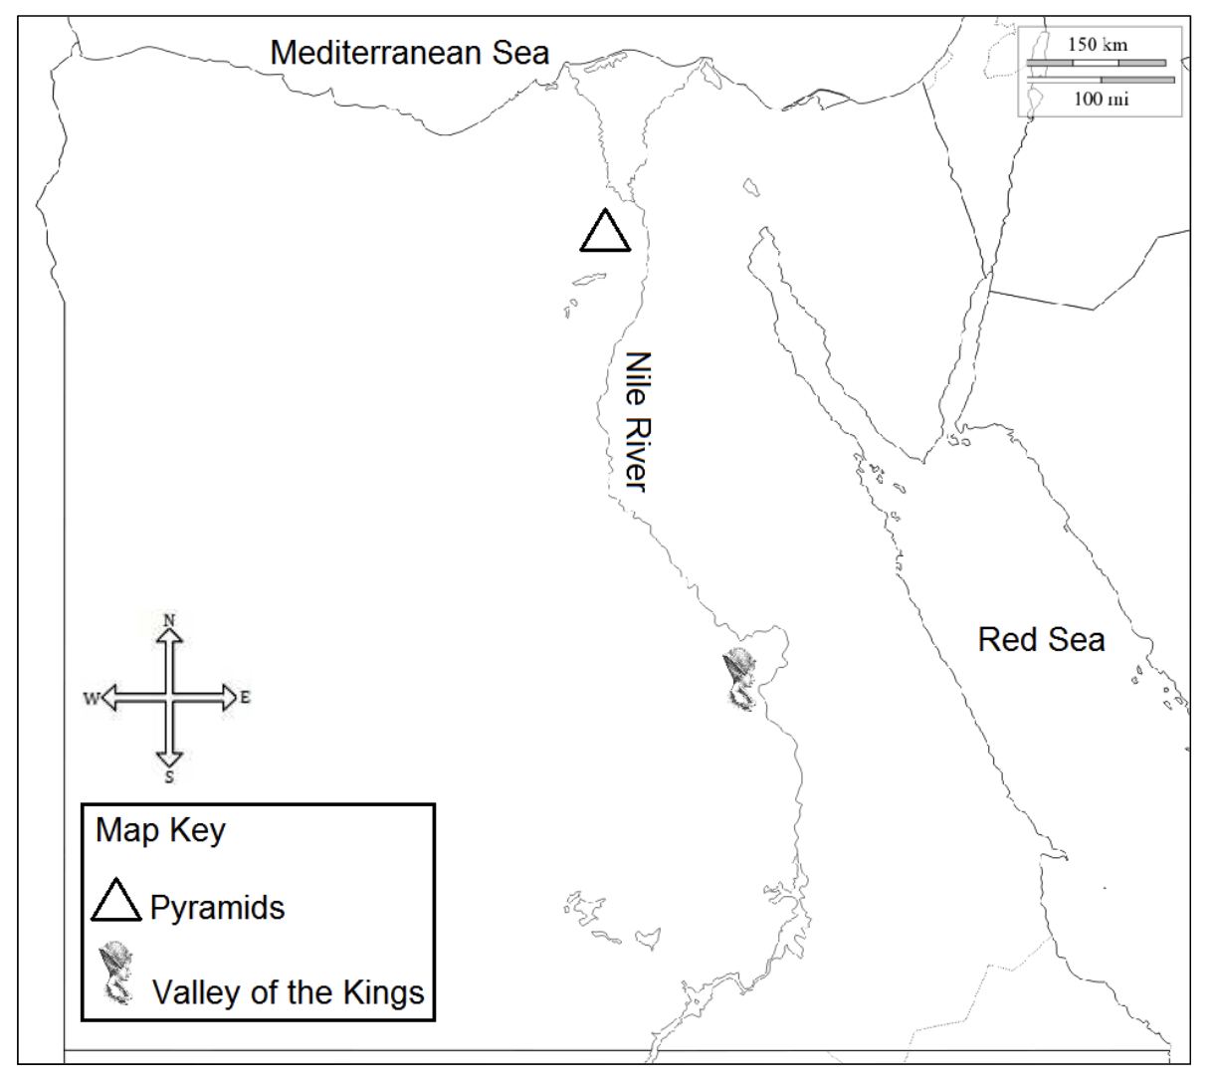

Slide 14
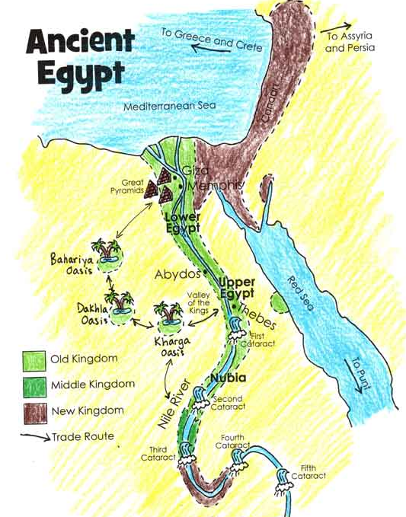

Slide 15
The Nile
Begins in central Africa and flows north into the Mediterranean Sea.
Desert = Nile as very important geographical feature
so crucial for survival that the people worshipped it as a god - called this god 'Hapi.
The Nile has three main sources - the White Nile, the Blue Nile and the Atbara River.
The Blue Nile and the Atbara River begin in the highlands of central Africa.
Every summer, they are flooded by melting snow and heavy rains.
These waters gush into the Nile, carrying a load of dark mountain silt - soil that is rich in nutrients.
Every year, this increase in water caused the Nile to burst its banks and flood parts of Egypt.

Slide 16
The Nile
Every year in June, the Nile would flood its banks and leave a pile of dark, fertile soil all over the land nearby. This flooding season was known as the inundation. As soon as the floodwaters went back down, the farmers would plant crops such as barley and other grains. These crops would grow very quickly in this fertile soil.
The ancient Egyptians called the fertile land with rich dark soil around the river the 'Black Land'. This was where most people lived.
On each side of the Nile, beyond the Black Land, were large areas of desert.
The ancient Egyptians named these areas the ‘Red Land'. Hardly anyone lived in the Red Land.

Slide 17
The Nile
It provided fresh water for drinking and bathing.
The ancient Egyptians used spears and nets to catch fish, birds, such as ducks and geese, that lived near it and used them for food.
They picked wild reeds, called papyrus, which grew alongside the river. The ancient Egyptians used these reeds to make a type of paper and boats.
The Nile also allowed the ancient Egyptians to travel quickly from place to place, so that they could trade with each other.

Slide 18
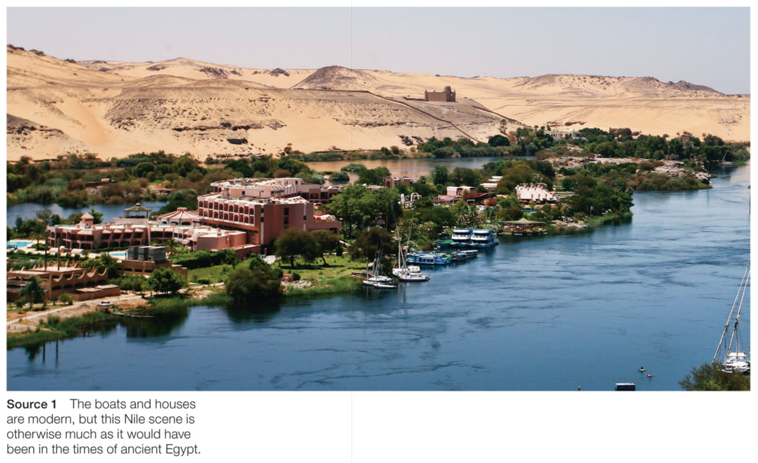

Slide 19
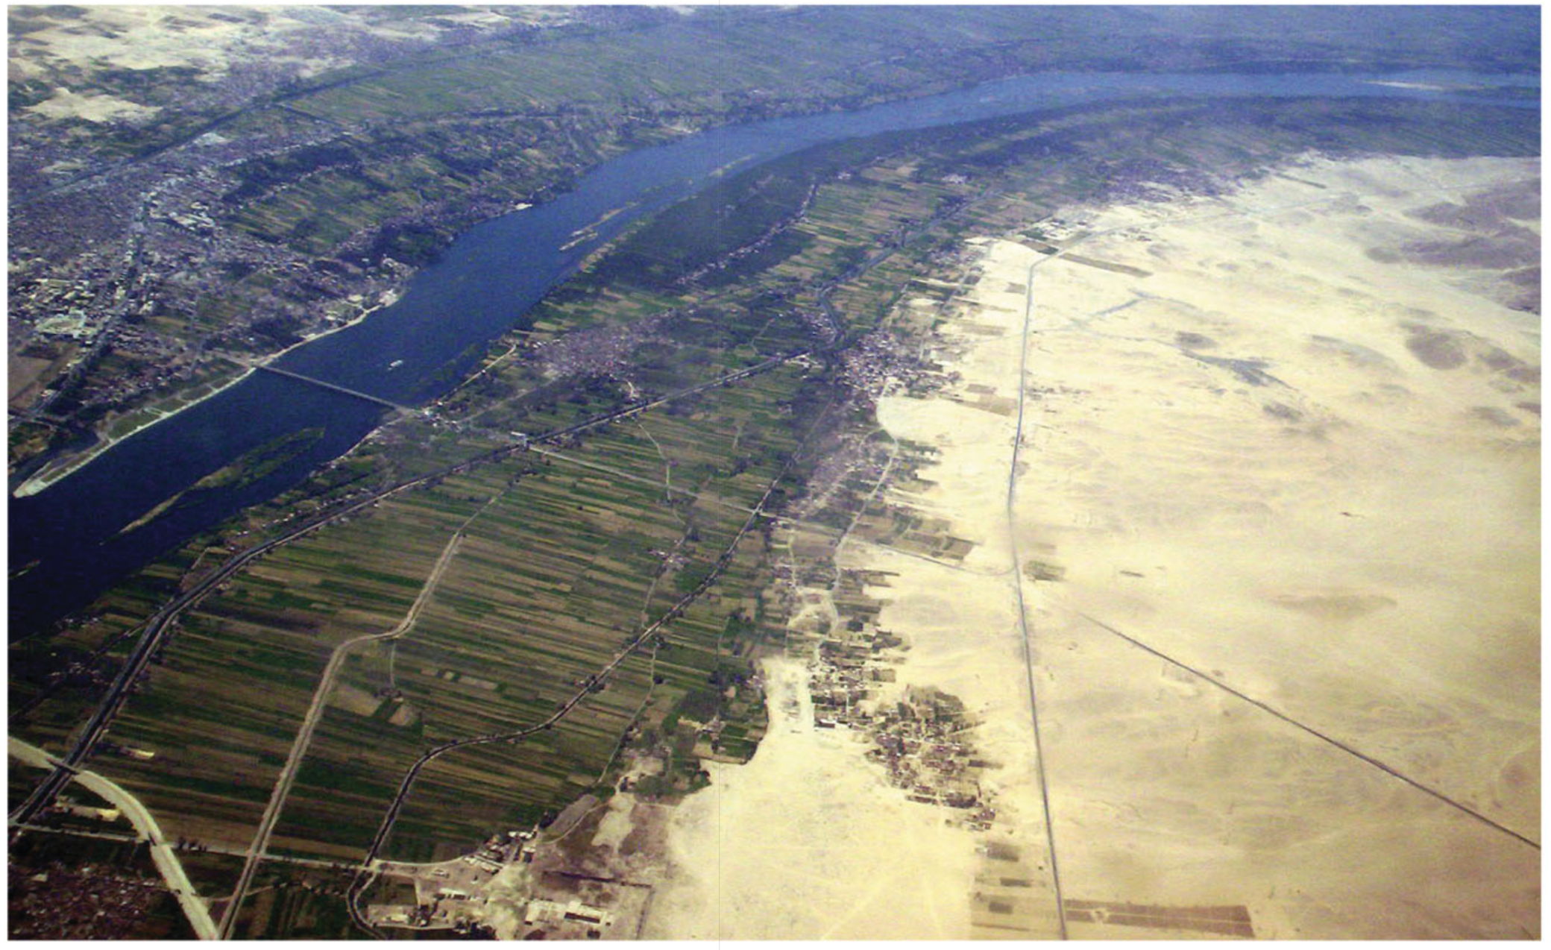
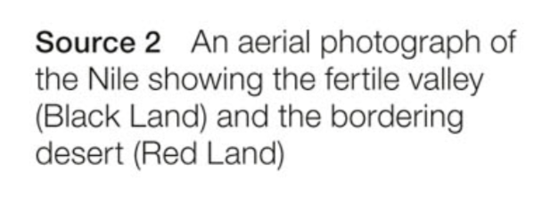

Slide 20
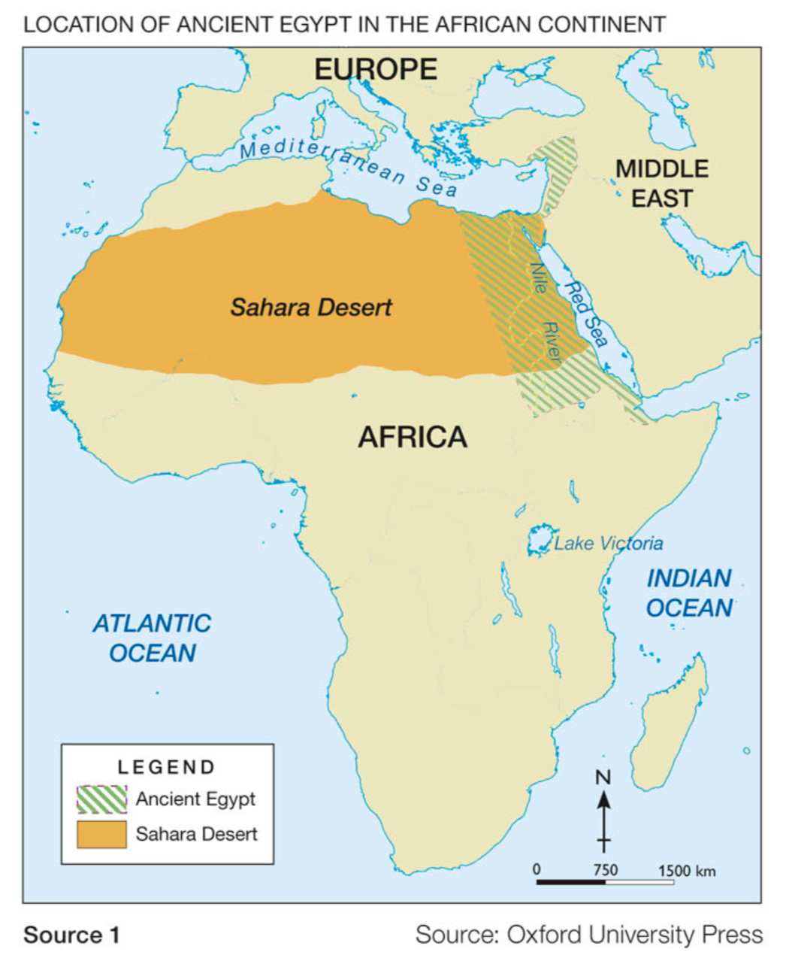
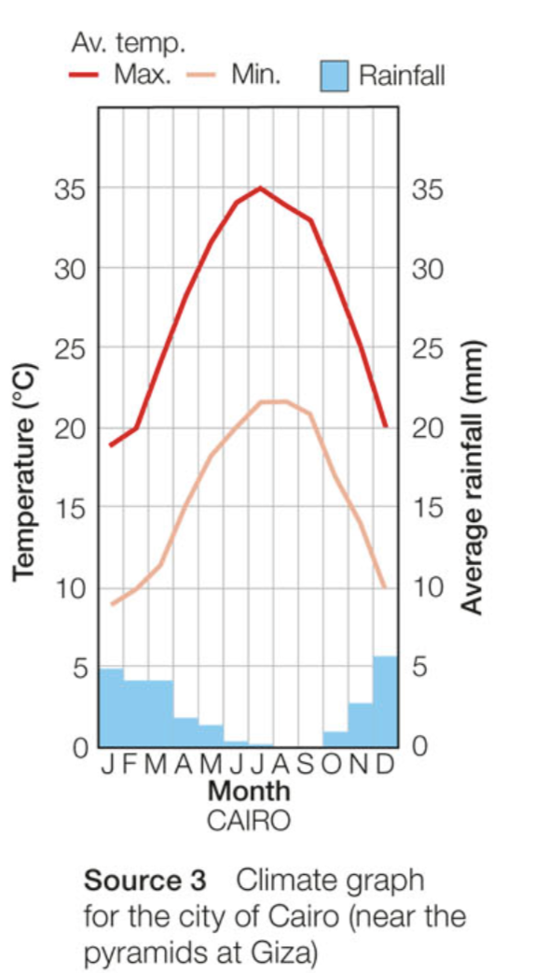
Analyse these sources
How do you think the climate impacted the lifestyles of the Ancient Egyptians?

Slide 21
The Desert - Summarise
Being surrounded by desert provided Egypt with some security against attacks. Any army that wanted to attack would have had a long, hot walk if invading from the east or the west.
The desert around ancient Egypt was inhabited by many different animals that were hunted by the ancient Egyptians for food. These animals included gazelles, hares and foxes.
The desert was also the source of minerals, rocks and metals, which the Egyptians used for building houses, pyramids, statues and tombs, and making weapons and jewellery.
The ancient Egyptians were able to trade many of these resources, as well as the products they made from them.

Slide 22
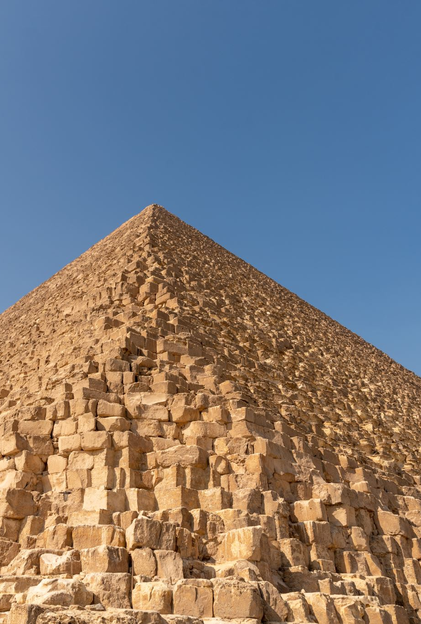
SUMMARY
Describe the geography of Ancient Egypt in 10 separate words.

